Slide 1
Presented By:
YASH JAISWAL

Slide 2
Cause Of Death
1) A Focus of Mortality
2) Cause of suffering to people
3) Measuring lost Health
4) Global Burden of Disease Study
5) Population and over Time

Slide 3
INTRODUCTION
In this Dataset, we have Historical Data of different cause of deaths for all ages around the World. The key features of this Dataset are:

Slide 4
PROBLEM STATEMENT
In this Dataset, we have Historical Data of different cause of deaths for all ages around the World. The key features of this Dataset are: Meningitis, Alzheimer's Disease and Other Dementias, Parkinson's Disease, Nutritional Deficiencies, Malaria, Drowning, Interpersonal Violence, Maternal Disorders, HIV/AIDS, Drug Use Disorders, Tuberculosis, Cardiovascular Diseases, Lower Respiratory Infections, Neonatal Disorders, Alcohol Use Disorders, Self-harm, Exposure to Forces of Nature, Diarrheal Diseases, Environmental Heat and Cold Exposure, Neoplasms, Conflict and Terrorism, Diabetes Mellitus, Chronic Kidney Disease, Poisonings, Protein-Energy Malnutrition, Road Injuries, Chronic Respiratory Diseases, Cirrhosis and Other Chronic Liver Diseases, Digestive Diseases, Fire, Heat, and Hot Substances, Acute Hepatitis.

Slide 5
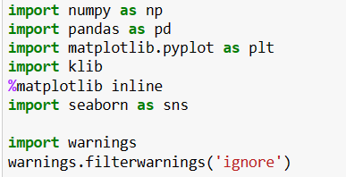
Libraries

Slide 6
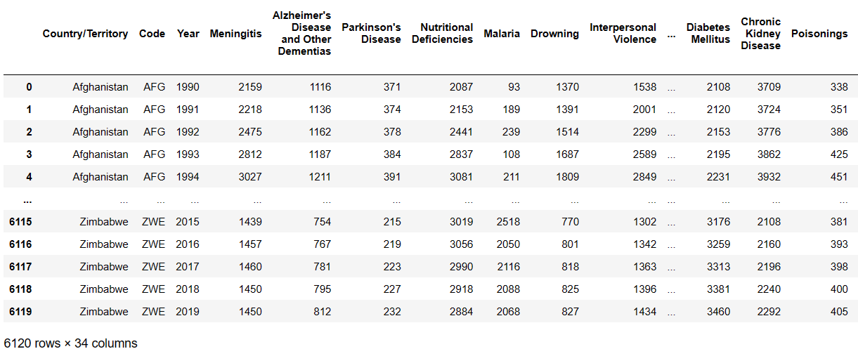
DATASET

Slide 7
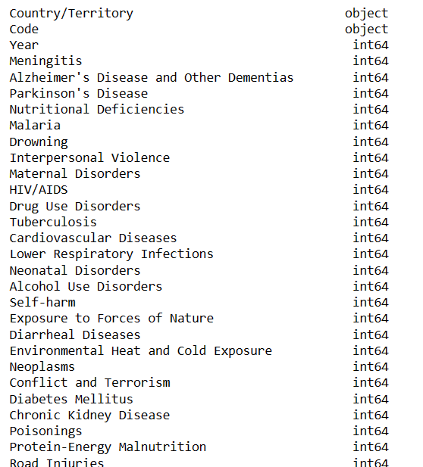
COLUMNS

Slide 8
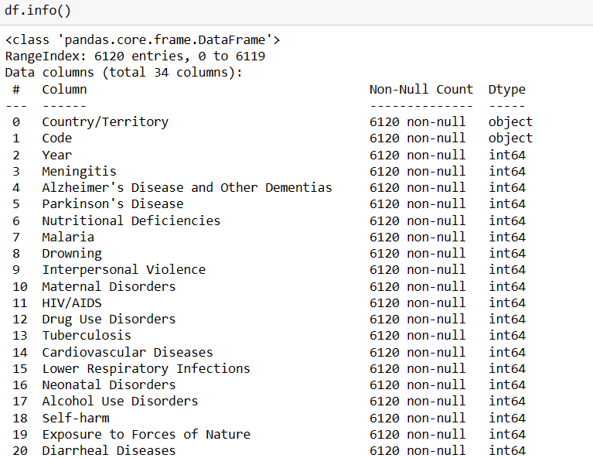
EDA

Slide 9
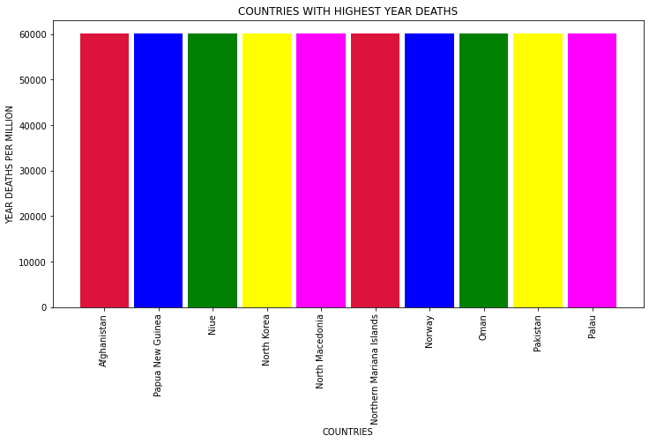
VISUALIZATION COUNTRY WITH HIGHEST YEAR DEATHS

Slide 10
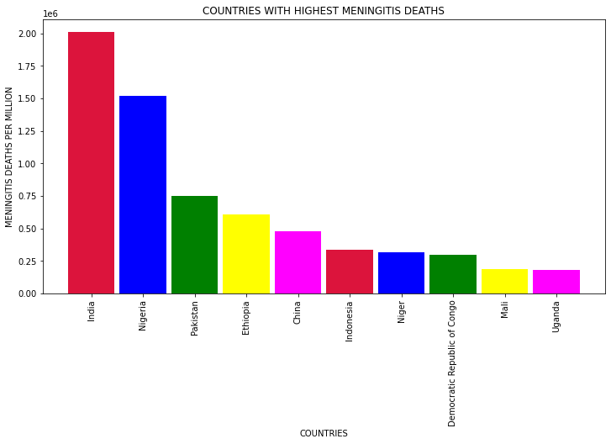
* MENINGITIS DEATHS = INDIA , NIGERIA , PAKISTAN this are top most country Meningitis deaths

Slide 11
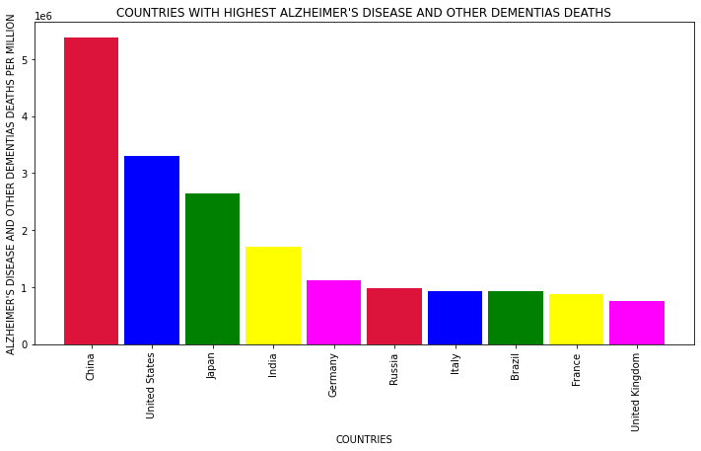
ALZHEIMER’s DISEASE AND OTHER DEMENTIAS DEATHS = CHINA US , JAPAN this are top most country are Dementias deaths

Slide 12
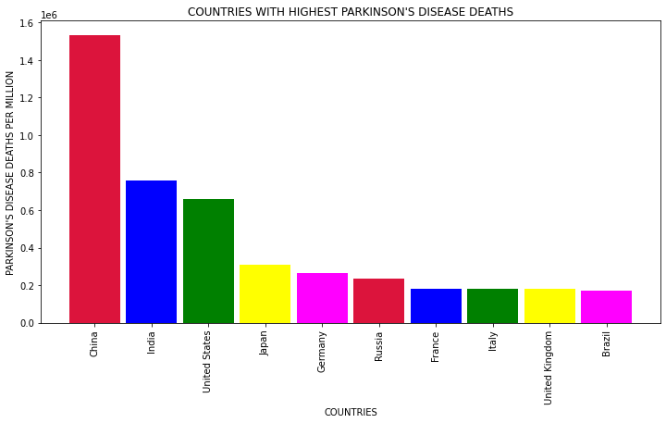
PARKINSON DISEASE DEATHS = CHINA , INDIA , US this are most top country Parkinson deaths

Slide 13
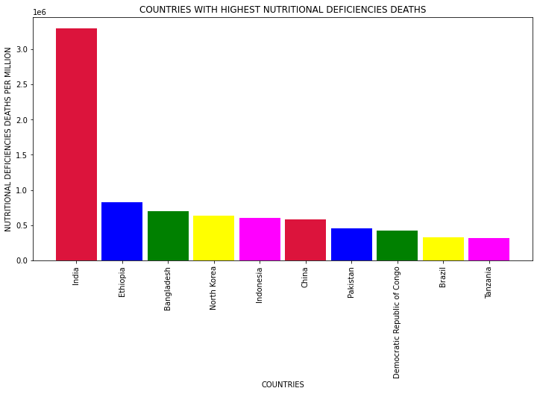
NUTRITIONAL DEFICIENCIES DEATHS = INDIA , ETHIOPIA , BANGLADESH this are top most country Nutritional deficiencies deaths

Slide 14
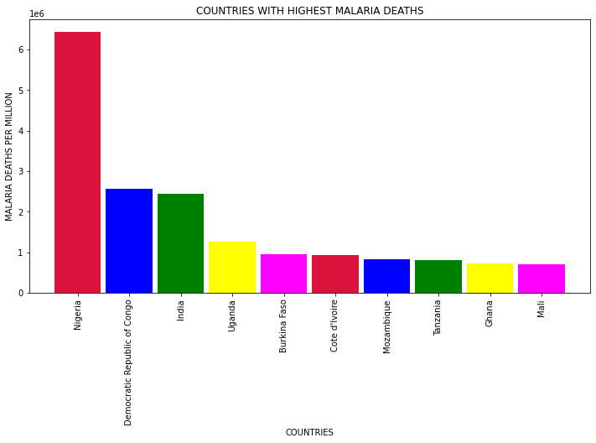
MALARIA DEATHS = NIGERIA , DEMOCRATIC , INIDA this are top most country malaria death

Slide 15
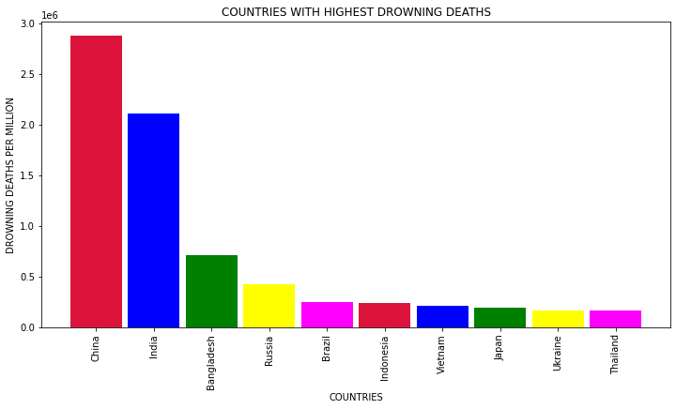
DROWNING DEATHS = CHINA , INDIA , BANGLADESH this are top most drowning deaths

Slide 16
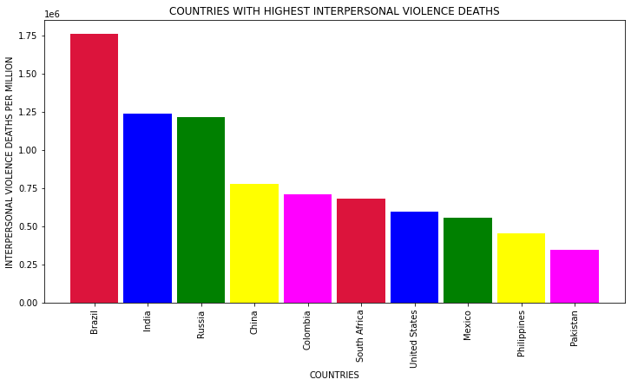
INTERPERSONAL VIOLENCE DEATHS = BRAZIL ,INIDA , RUSSIA interpersonal violence deaths

Slide 17
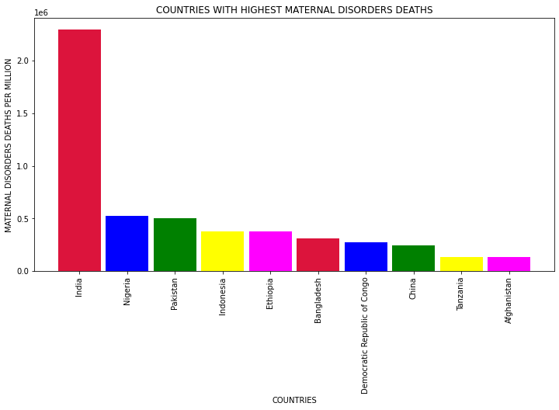
MATERNAL DISORERS DEATHS = INDIA , NIGERIA, PAKISTAN this are top most country

Slide 18
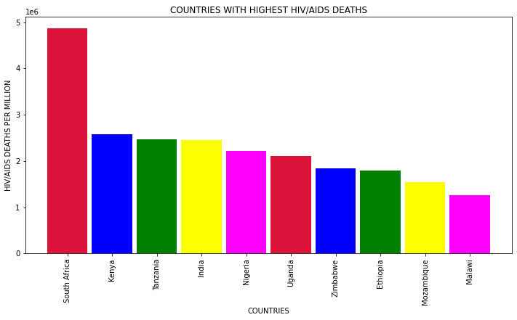
HIV/AIDS DEATHS = SOUTH AFRICA , KENYA, TANZANIA this are top most country

Slide 19
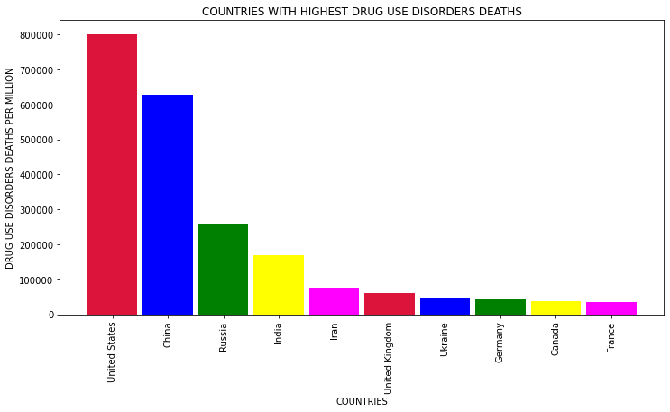
DRUG USE DIASORDERS DEATHS = US, CHINA, RUSSIA this are top most country

Slide 20
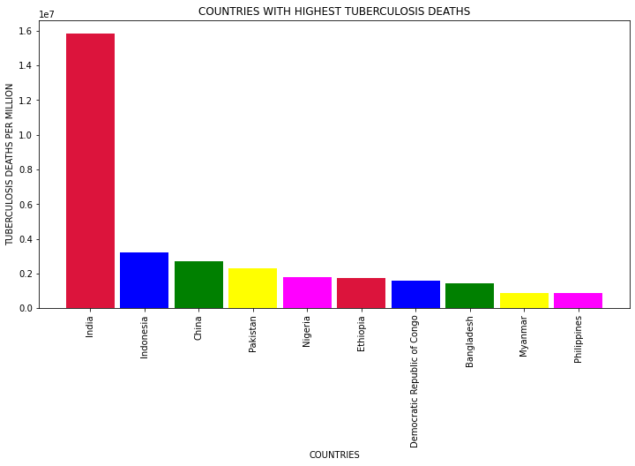
TUBERCULOSIS DEATHS = INDIA, INDONESIA, CHINA this are top most country

Slide 21
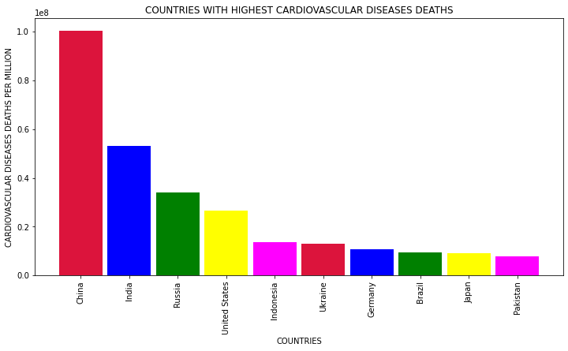
CARDIOVASCULAR DISEASES DEATHS = CHINA, INIDA, RUSSIA this are top most country

Slide 22
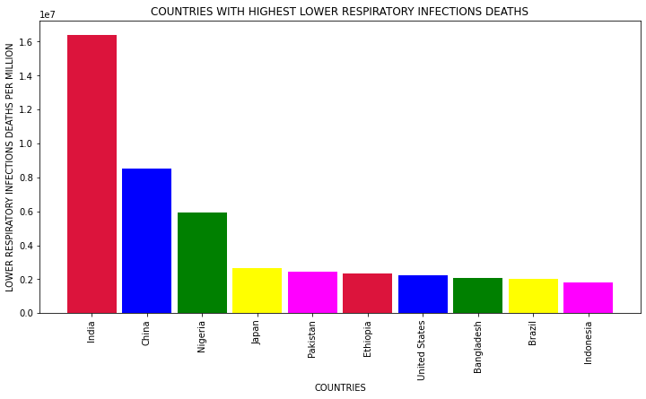
LOWER RESPIRATORY INFECTIONS DEATHS =INIDA, CHINA, NIGERIA this are top most country

Slide 23
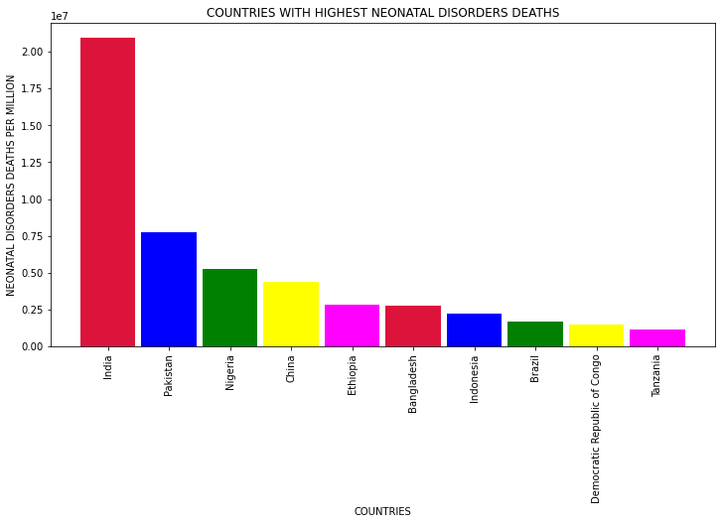
NEONATAL DISORDERS DEATHS = INDIA, PAKISTAN,NIGERIA this are top most country

Slide 24
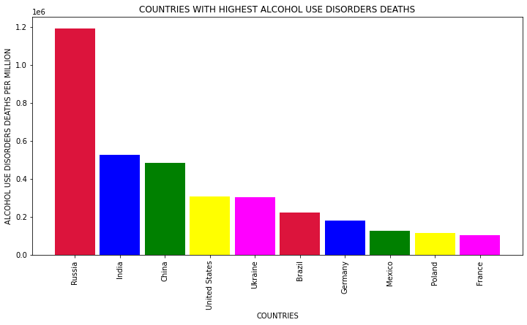
ALCOHOL USE DISORDERS DEATHS = RUSSIA, INIDA, CHINA this are top most country

Slide 25
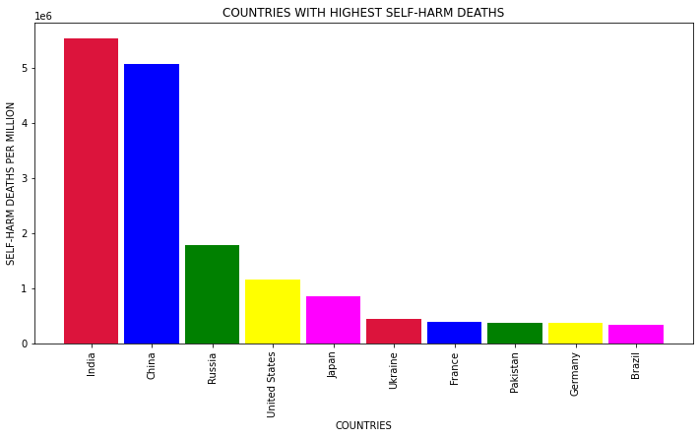
SELF-HARM DEATHS = INIDA,CHINA,RUSSIA this are top most country

Slide 26
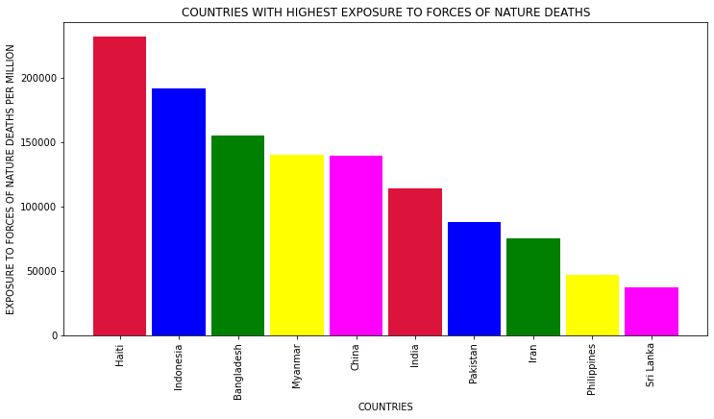
EXPOSURE TO FORCES OF NATURE DEATHS = INIDA,INDONESIA,BANGLADESH this are top most country

Slide 27
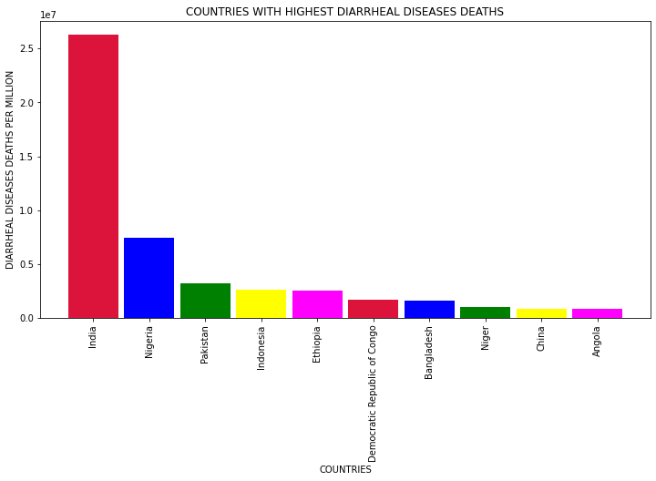
DIARRHEAL DISEASES DEATHS = INDIA, NIGERIA , PAKISTAN this are top most country

Slide 28
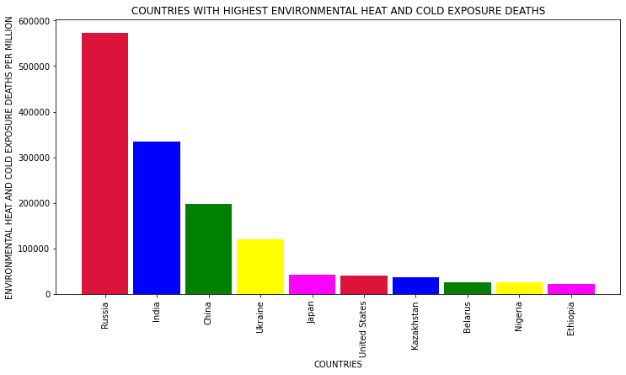
HEAT AND COLD EXPOSURE DEATHS = RUSSIA,INDIA,CHINA this are top most Country

Slide 29
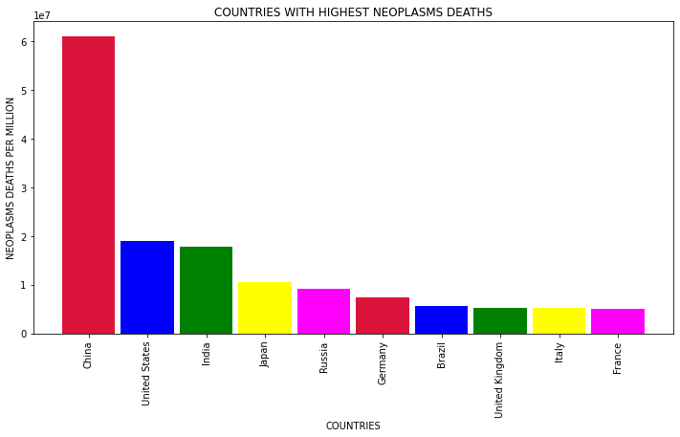
NEOPLASMS DEATHS = CHINA,US,INDIA this are top most country

Slide 30
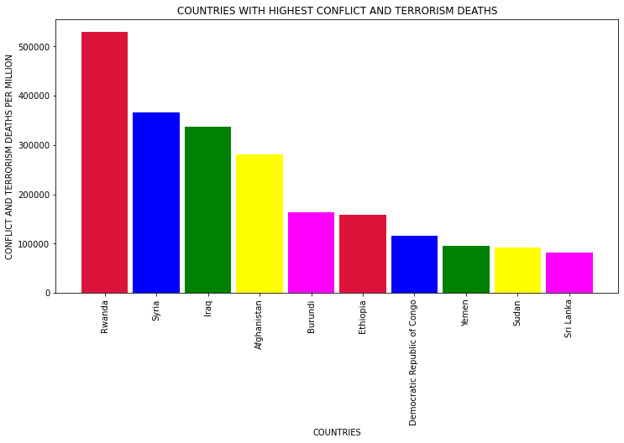
CONFLICT AND TERRORISM DEATHS = RWANDA , SYRIA,IRAQ this are top most country

Slide 31
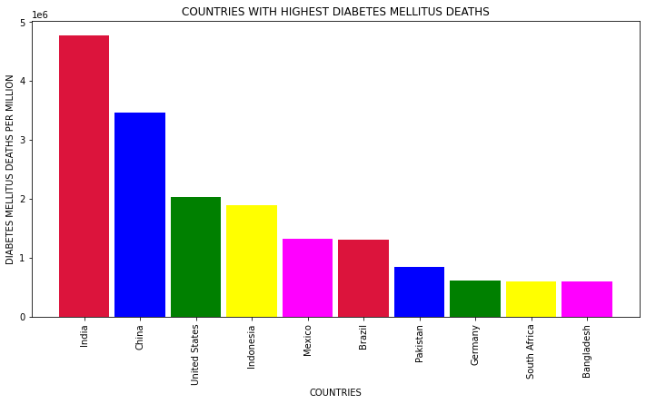
DIABETES MELLITUS DEATHS = INDIA,CHINA,US this are top most country

Slide 32
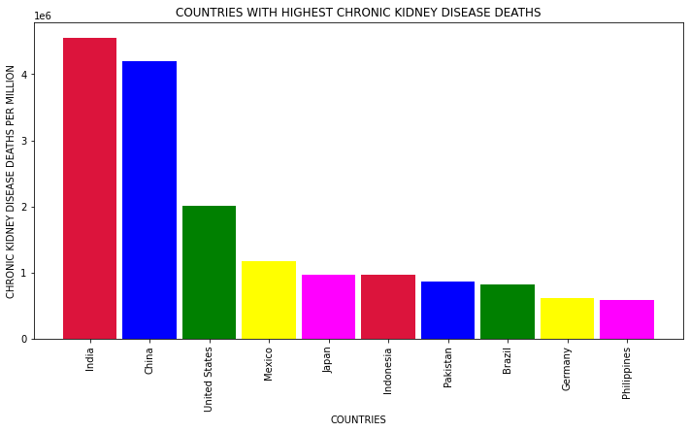
CHRONIC KIDNEY DISEASE DEATHS = INIDA, CHINA, US this are top most country

Slide 33
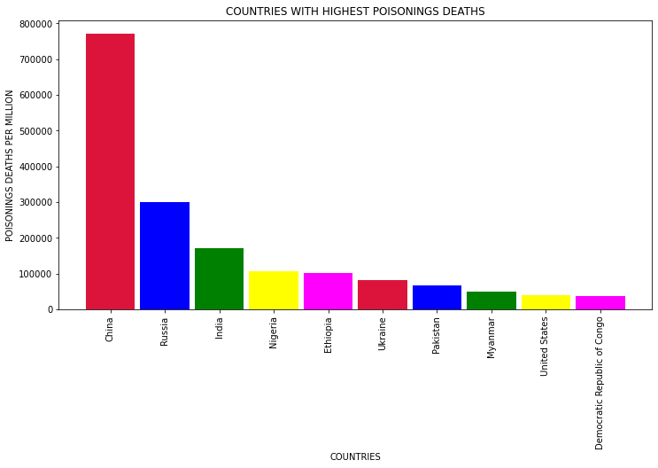
POISNINGS DEATHS = CHINA,RUSSIA,INDIA this are top most country

Slide 34
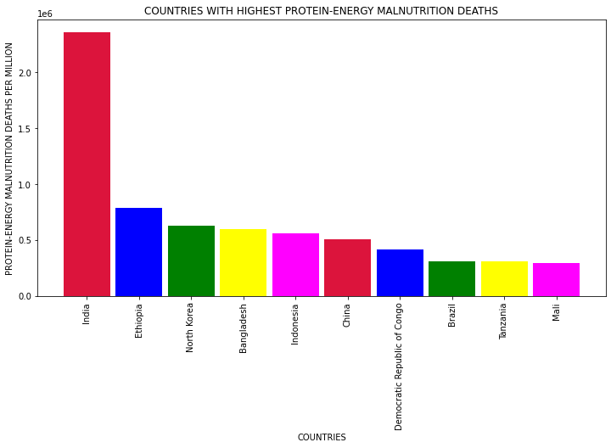
PROTEIN-ENERGY MALNUTRITION DEATHS = INIDA, ETHIOPIA,NORTH KOREA this are top most country

Slide 35
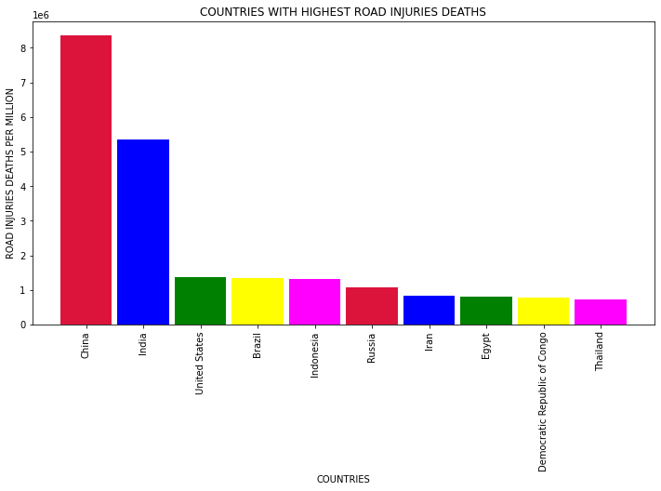
ROAD INJURIES DEATHS = CHINA,INIDA,US this are top most country

Slide 36
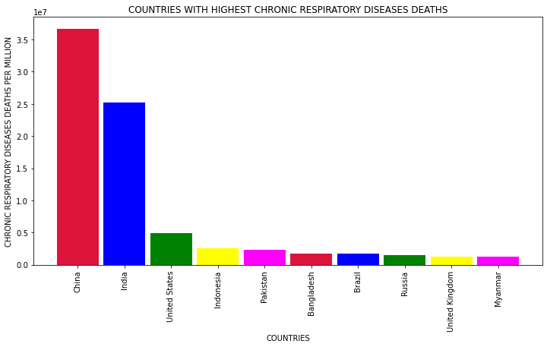
CHRONIC RESPIRATORY DISEASES DEATHS = CHINA, INIDA,US this are top most country

Slide 37
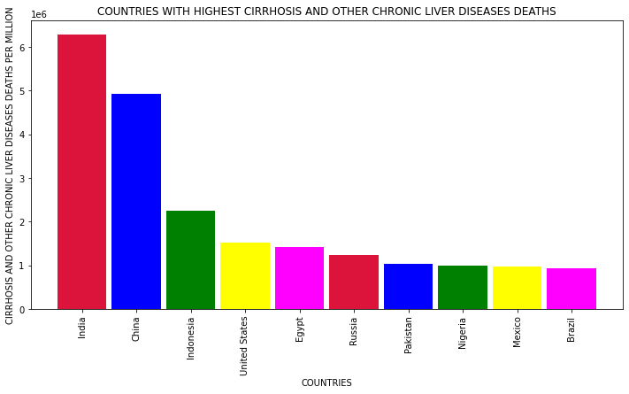
CIRRHOSIS AND OTHER CHRONIC LIVER DISEASES DEATHS = INIDA, CHINA, INDONESIA this are top most country

Slide 38
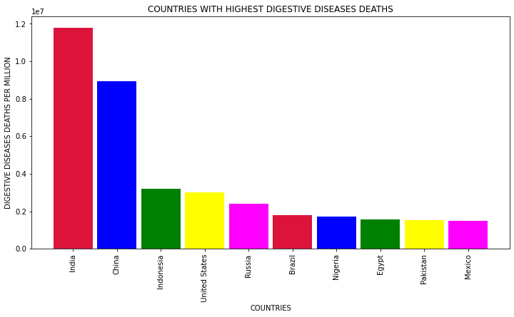
DIGESTIVE DISEASES DEATHS = INDIA, CHINA, INDONESIA this are top most country

Slide 39
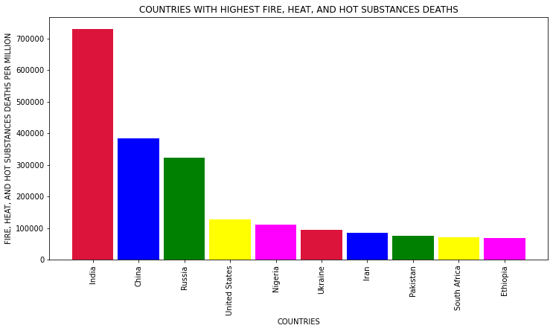
FIRE,HEAT,AND HOT SUBSTANCES DEATHS = INDIA , CHINA, RUSSIA this are top most country

Slide 40
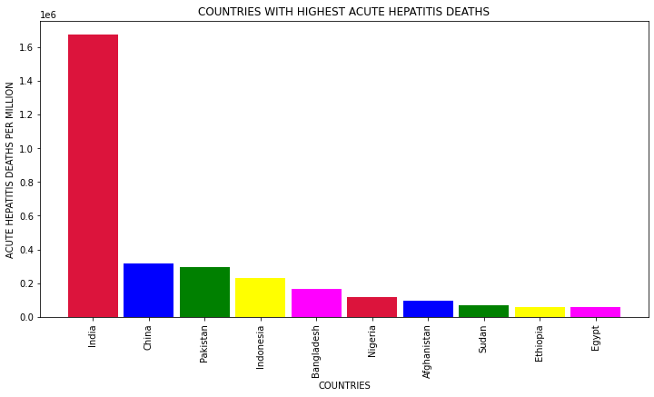
ACUTE HEPATITS DEATHS = INDIA,CHINA,PAKISTAN this are top most country

Slide 41
CAUSE OF DEATHS
WHICH ARE THE COUNTRIES FACING OVERALL HIGHEST DEATHS DUE TO DISEASES

Slide 42
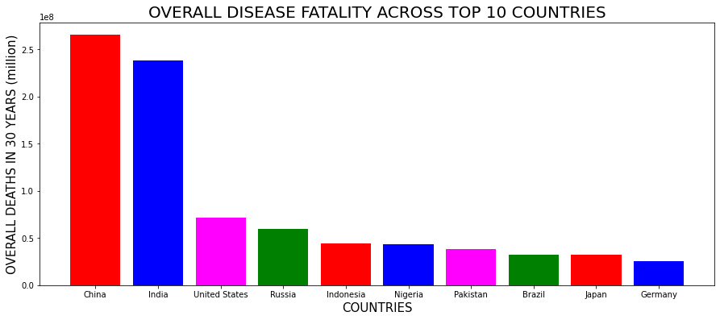
OVERRALL DISEASE FATALITY ACROSS TOP 10 COUNTRIES

Slide 43
CAUSE OF DEATHS
WHICH ARE THE TOP KILLER DISEASES IN THE WORLD

Slide 44
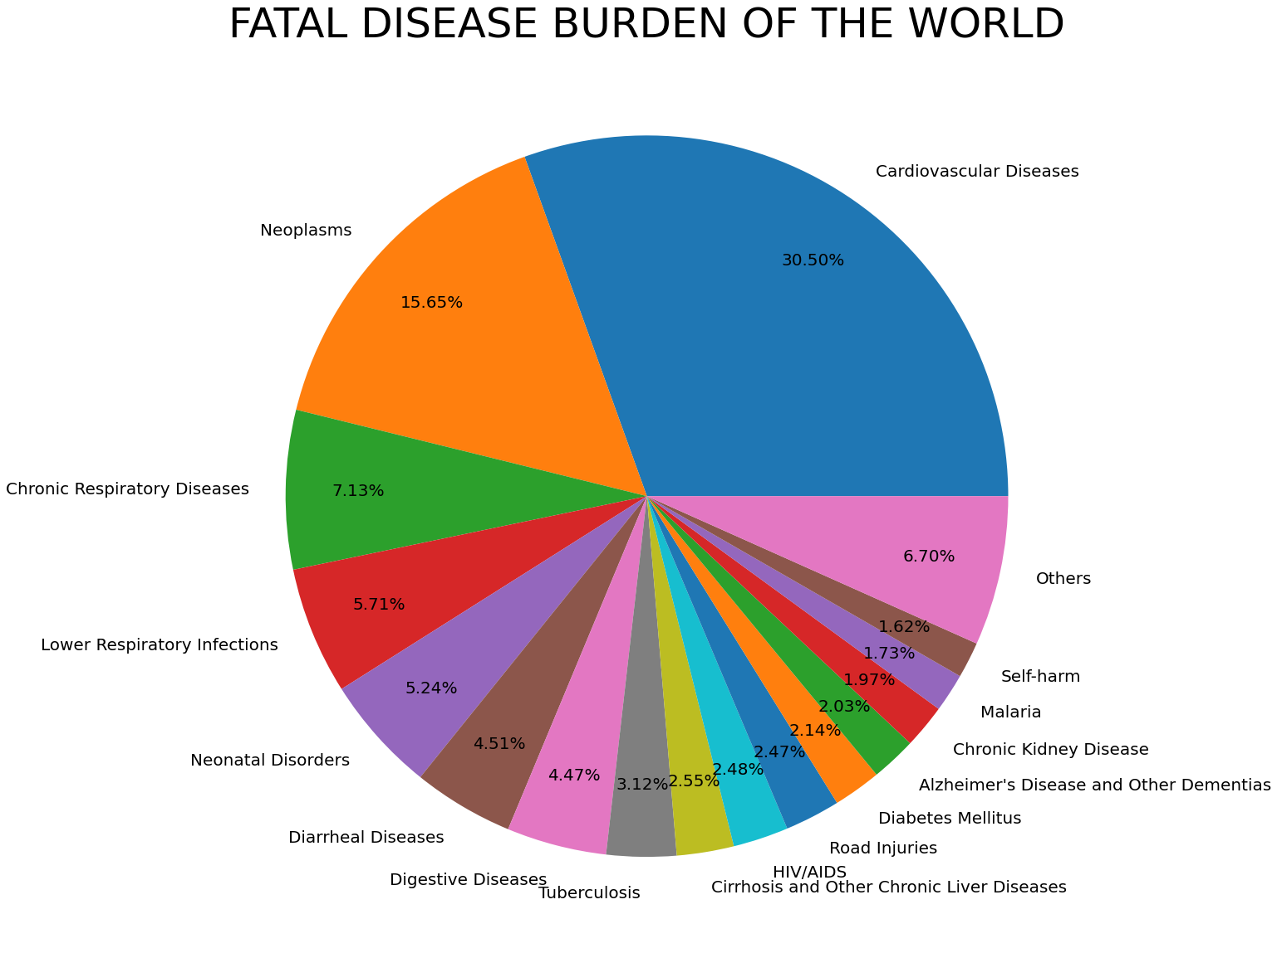
FATAL DISEASE BURDEN OF THE WORLD

Slide 45
THANK YOU
____

